Slide 1
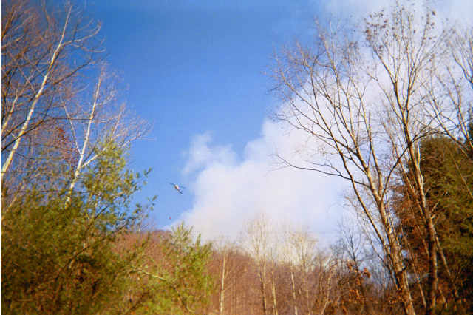
New NWS Online Spot Program
Part I – Submit Spot Request
Created by Eric Evenson WFO Burlington, VT
Adopted for WFO Jackson, KY CWA by Jon Pelton
Red Bird Fall Fires 2001

Slide 2
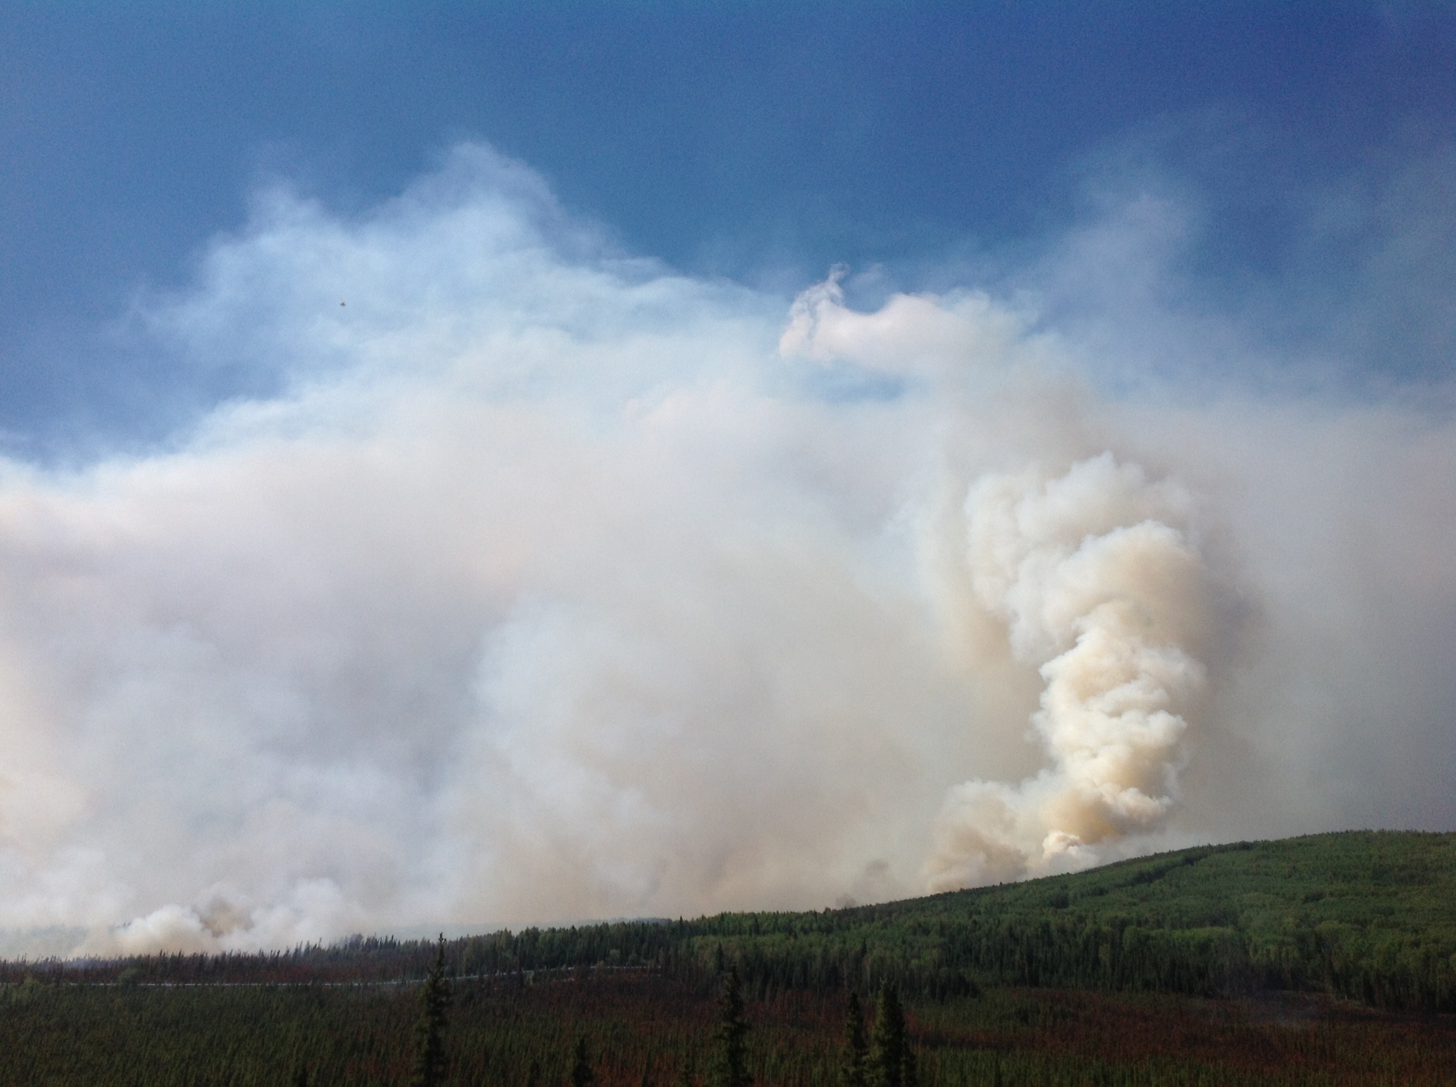
The National Weather Service produces a wide variety of forecasts around the clock using a database consisting of thousands of forecast points.
Extra meteorological detail can be added to any of these forecast points via a spot forecast.
A spot forecast is a detailed site-specific forecast issued for wildfires, prescribed burns, HAZMAT incidents, search and rescue operations, etc. and are available upon request anytime.
The following presentation details the new online spot program and the process of requesting/receiving a spot forecast.
Aggie Creek Fire, AK - Photo Credit: Eric Evenson

Slide 3
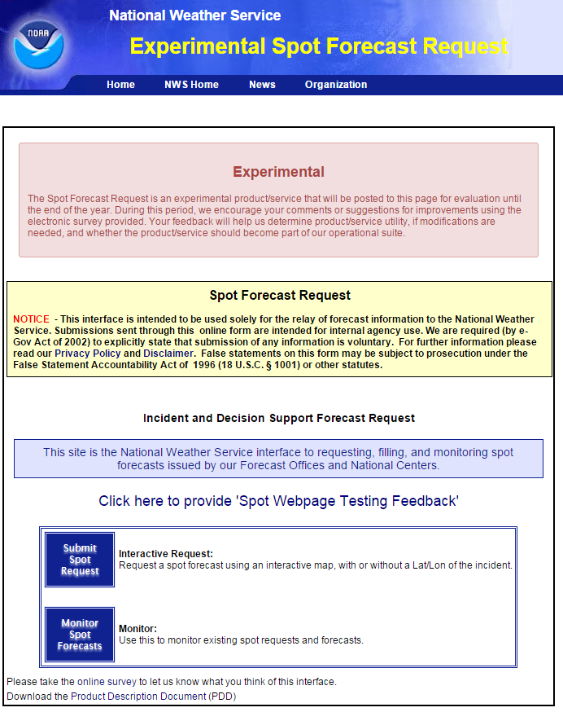
www.weather.gov/spot
Two Options On This Page
Submit Spot Request
Monitor Spot Forecasts
Please contact NWS Jackson, KY or your local NWS office after you submit a spot request to ensure it has been have received.
When using the new online spot request page in real time, select the Submit Spot Request button to continue.

Slide 4
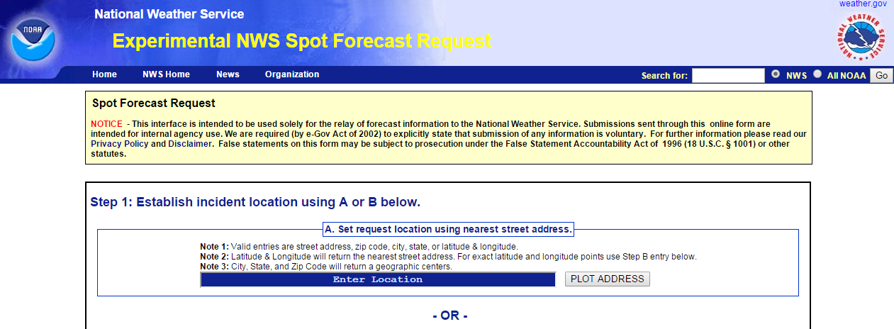
Establish A Location One Of Two Ways (Option A)
Enter location in the blue “Enter Location” box using a street address, zip code, city, state, or a latitude & longitude.
Select the PLOT ADDRESS and your location will show up on the Google Map (next slide).
You will be able to fine tune the point if its not the exact location you wish.

Slide 5
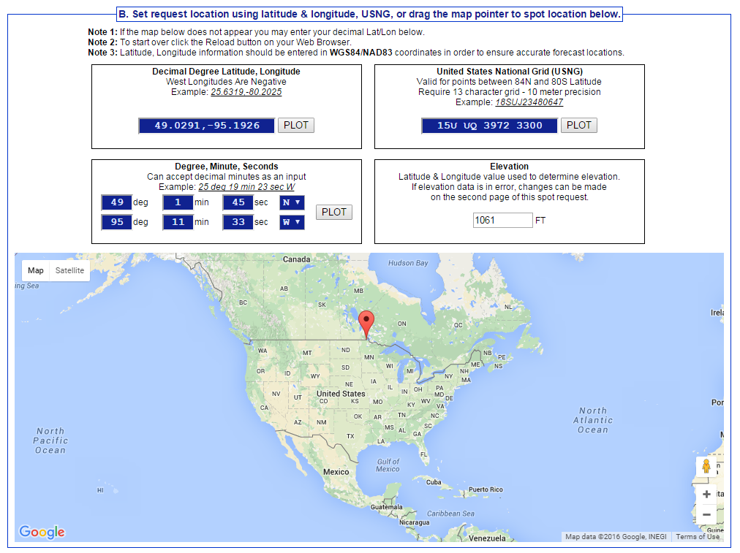
Establish Location One Of Two Ways (Option B)
If you did not have a specific location as in option A, you can “left click” and drag the pointer to a specific location.
Fine tune the point by zooming in/out on the map until you find the spot you are looking for. You can change the map to Satellite view for more detail.
NOTE – when moving the pointer around on the map, information related to the latitude and longitude will automatically adjust in the blue boxes as well as providing you with the elevation.

Slide 6
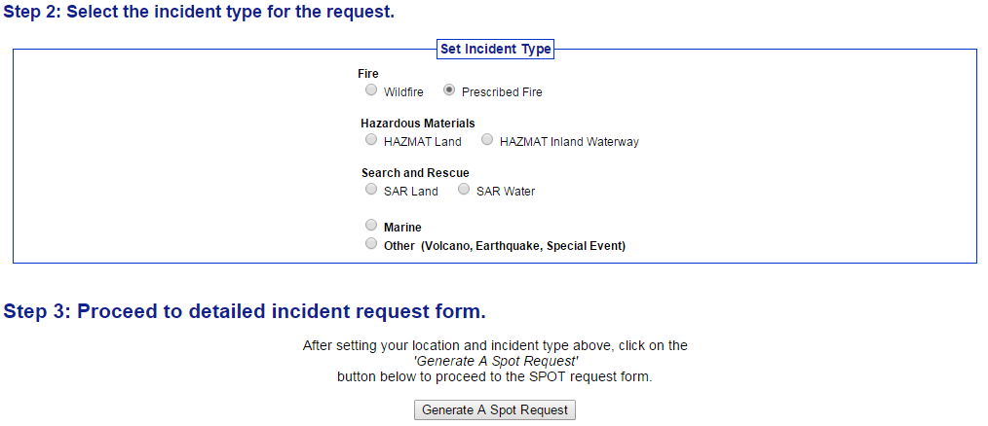
Select The Incident Type
Now that you have your location set, select an incident type.
Note there are more options to choose from than in the past.
For this tutorial, we will select Prescribed Fire and click Generate A Spot Request.

Slide 7
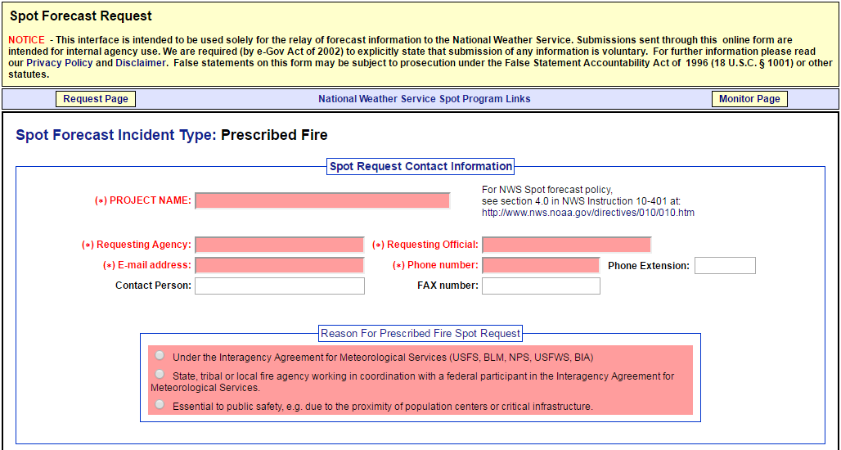
Spot Request Contact Information
Boxes shaded in red are required. This page is essentially the same as the previous online spot program.

Slide 8
Location And Supplemental Information
Boxes shaded in red are required. Location and elevation will already be filled in based on the spot you chose on the map. Change if in error or if there is a range in elevations for the incident note but filling in the TOP and BOTTOM elevations.
Although nothing is required in the Fire Weather Supplemental Information section any additional information provided in this section will aid in providing the best forecast possible.

Slide 9
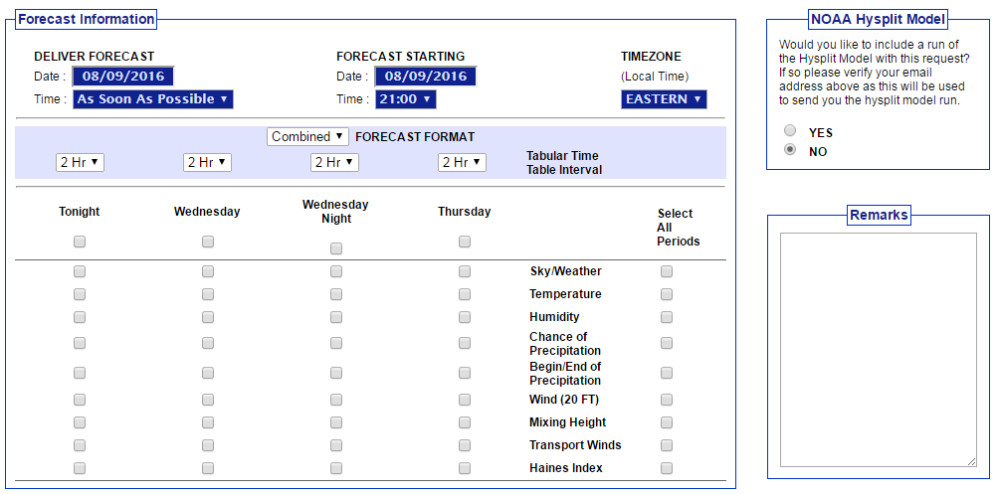
Check Deliver Forecast & Forecast Starting times and dates (use pulldowns to change times) (local time 00:00 = midnight, 12:00 = noon, 18:00 = 6pm). Check Timezone.
NOAA Hysplit Model (tracks where smoke, particulates, chemicals may go over time) click yes or no for a run to be emailed to you. This is defaulted to no.
Remarks box provide any other relevant information related to incident here.
Select elements you want included in the forecast. These can choosen by element, day, or all periods.

Slide 10
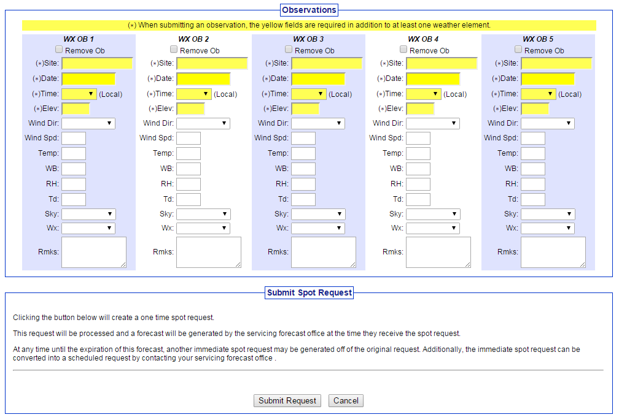
Input any observations and select Submit Request
Please Call NWS Jackson, KY to ensure receipt of the request.

Slide 11
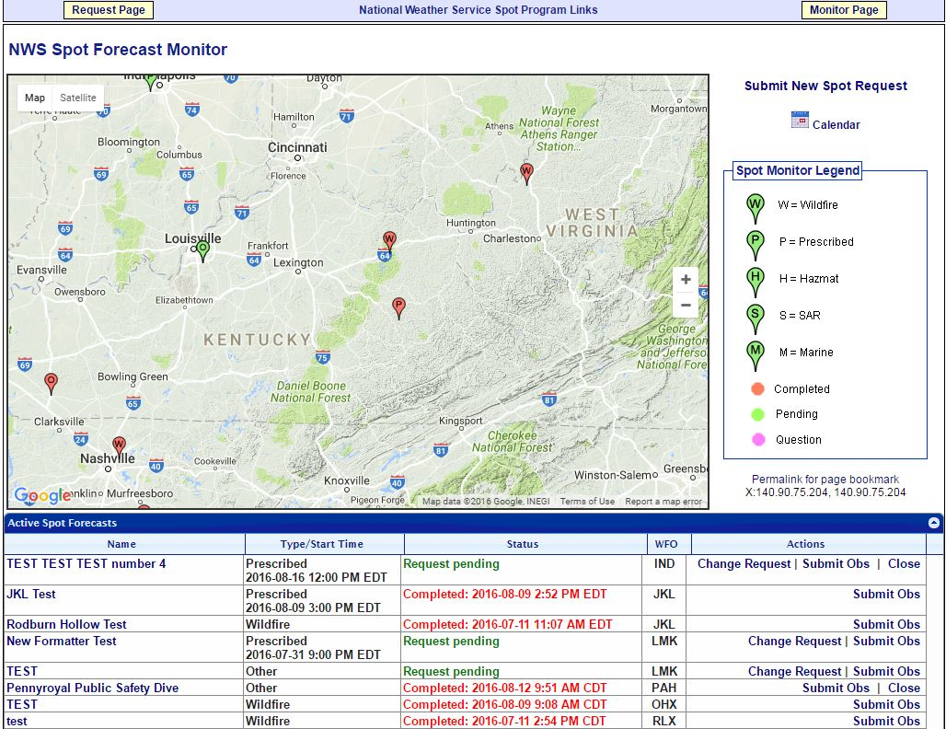
Once you submit the spot request NWS Spot Forecast Monitor page will appear.
You will see a pin for the location of the spot that was submitted.
Note you may see other pins for current/previous spot requests.
Zooming in/out will change which spot requests get shown.
Note the Spot Monitor Legend to the right of the map. The green color indicates your spot request is pending and the NWS is working on the forecast.
Below the map is the spot request you submitted. If you need to change the request or submit an observation you can do so using the links under the Actions column.

Slide 12
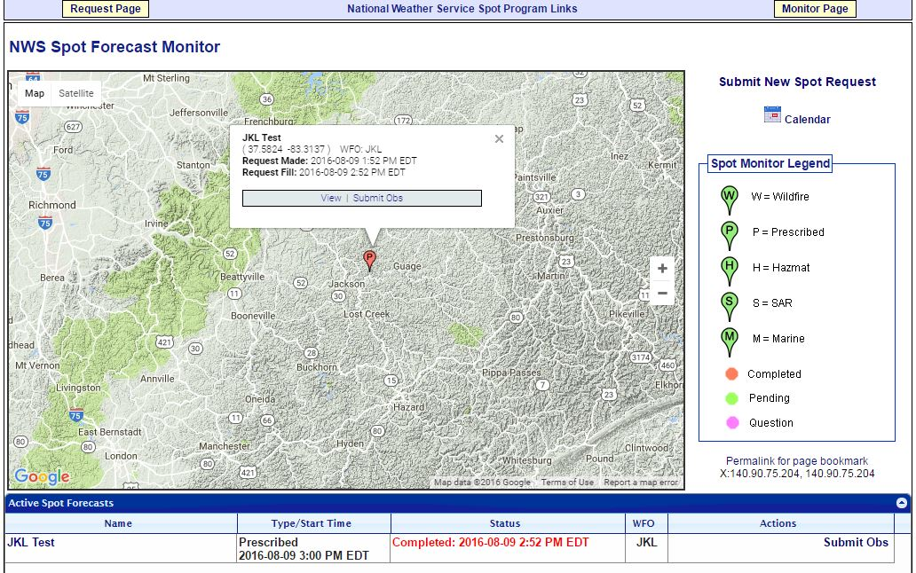
Other Functionality
You can zoom in on the map and click the pin for additional information. You can also click the Permalink for page bookmark and then copy the web address in the browser to share with anyone else that may need information related to the spot.

Slide 13
Completed Forecast
Pin color will change to red indicating forecast is complete. Click the name of your request in the Active Spot Forecasts section below the map to view the forecast.

Slide 14
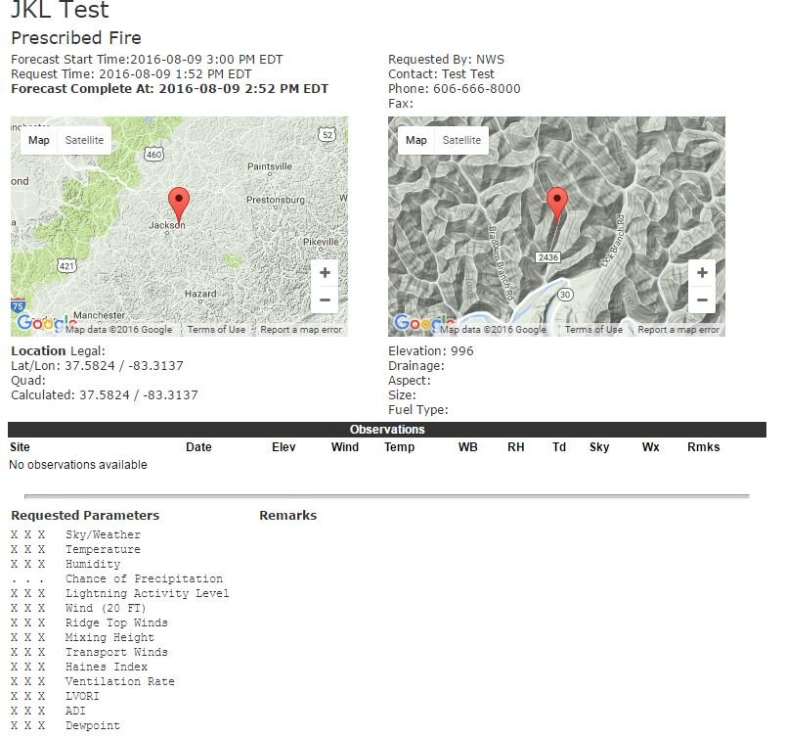
The forecast page will show you the data you input for the spot as well as two maps showing the location of the spot request.
Note – to ensure you have received the forecast you likely will receive a call from the NWS. Or feel free to call NWS Jackson, KY or your local NWS office if you have any questions related to the forecast.

Slide 15
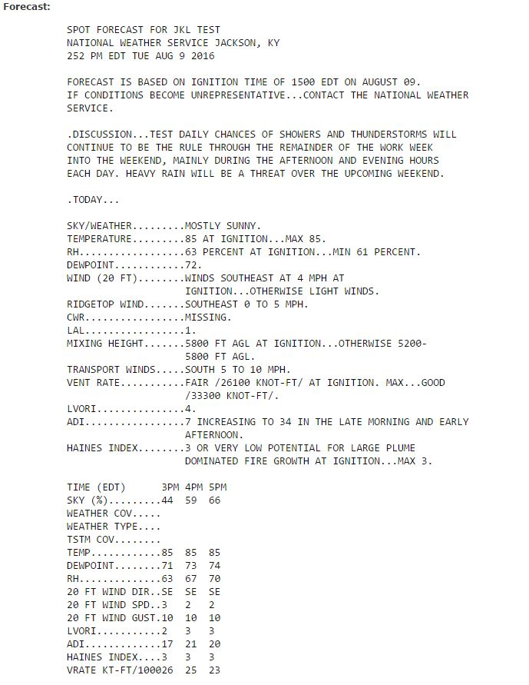
And here is the forecast related to your spot request.
Please call NWS Jackson, KY or your local NWS office if you have any questions related to the forecast.
The remainder of the forecast will appear on the next slide.

Slide 16
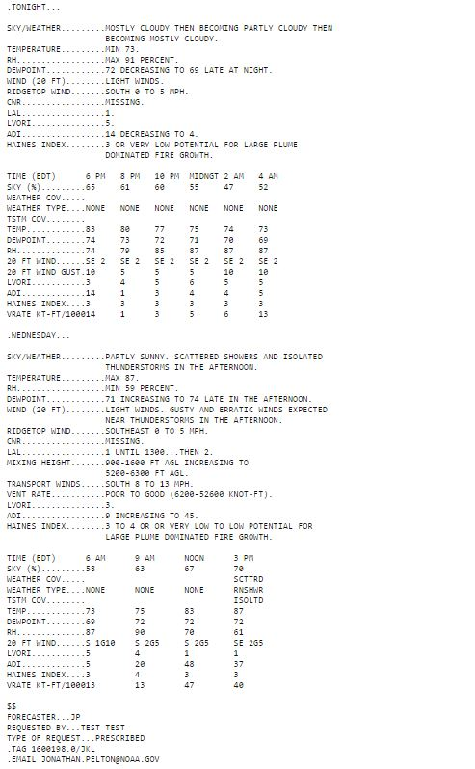
And here is the rest of the forecast related to your spot request.
Again, please call NWS Jackson, KY or your local NW Office if you have any questions related to the forecast.

Slide 17
At the bottom of the forecast is a section for feedback. It is encouraged to leave feedback related to the forecast and/or how the operations fared. It will help us improve our forecasts and services for future spot requests. Other actsions such as Copy Info to Spot Request for a New Incident, Copy Info to New Spot Request for this Incident

Slide 18
Links at the bottom of the page that may be of value to you include:
Printer Friendly Version of Forecast – self explanatory
Back to Forecast Monitor – a link back to the NWS Spot Forecast Monitor page.
Copy Info to Spot Request for a New Incident: takes you to the spot request page to select a location, but has the spot request contact information from your last spot.
Copy Info to New Spot Request for this Incident: keeps location and contact information you entered for this spot to expedite the process of submitting a new spot quicker.
Request Immediate Forecast Update: if forecast is not representative and you need an update. You will be taken to a page that gives you a chance to submit a weather observation if you have one. If not click the “Request Update” button to submit the request for a new spot forecast.
Delete Request: use this link to delete the spot forecast request altogether.

Slide 19
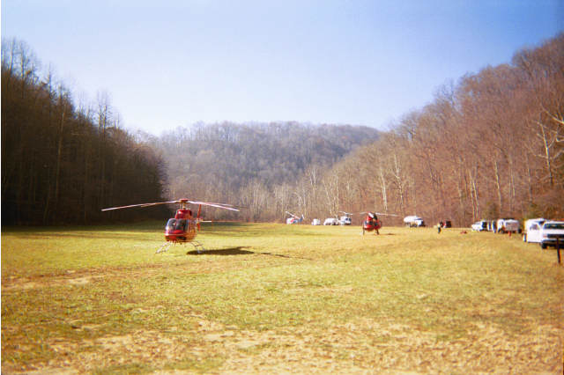
This has been an overview of the new NWS online spot program and the simple steps needed to request/receive a spot forecast.
Red Bird Fall Fires 2001

